Slide 1
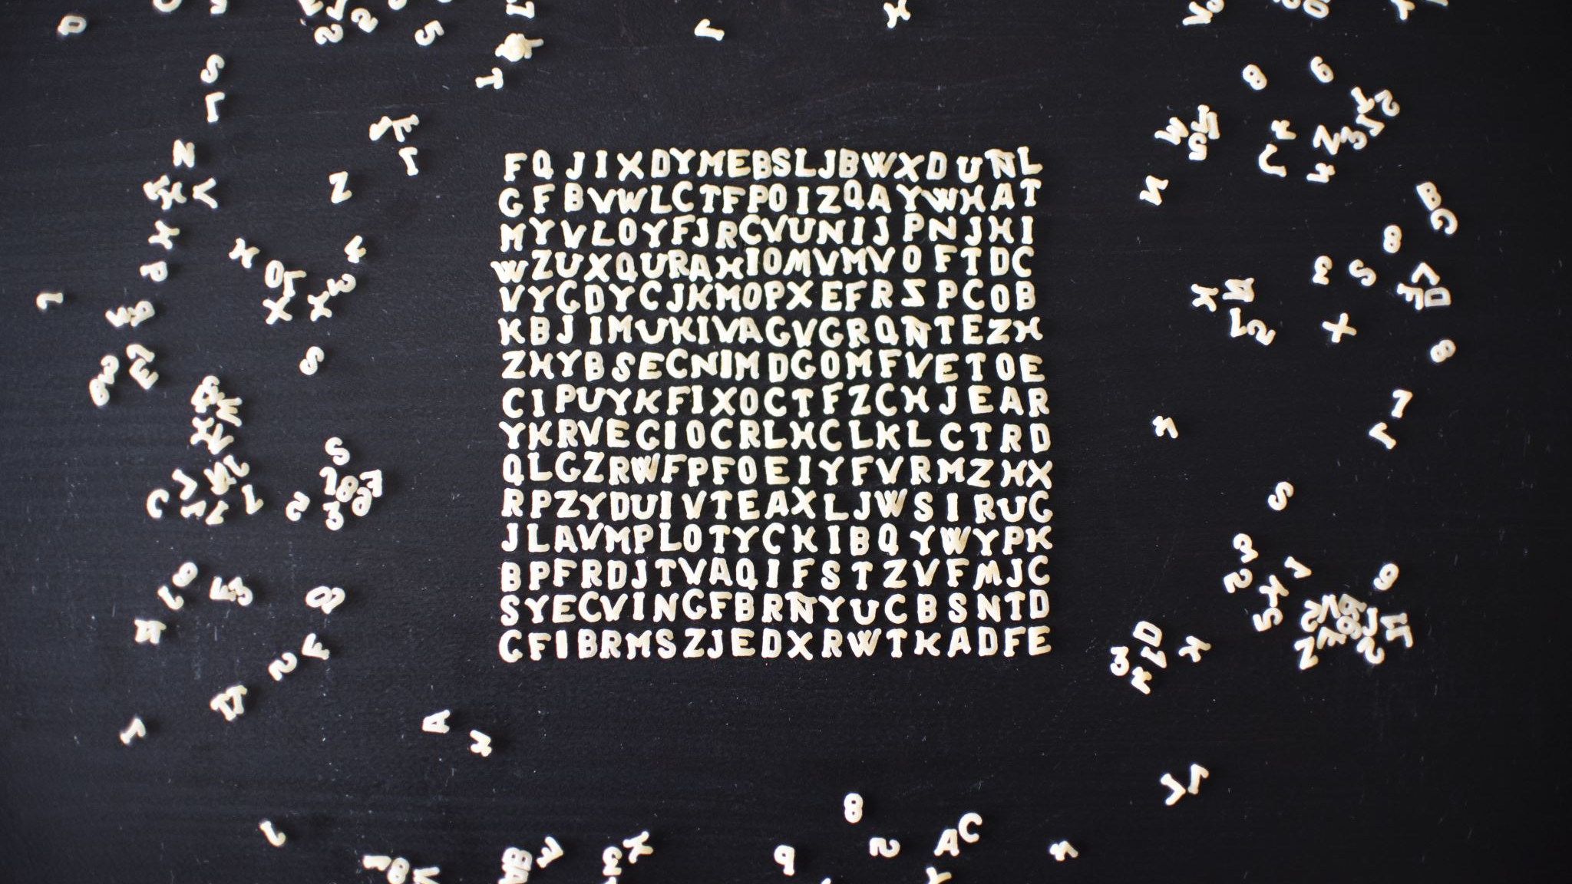
Analysis of Song Lyrics for Classification and Predictive Purposes
Gurmat Singh (Song) Sour
Minh (Paul) Nhat Mai (Sharona)
Robert (Ozzy) Seibel

Slide 2
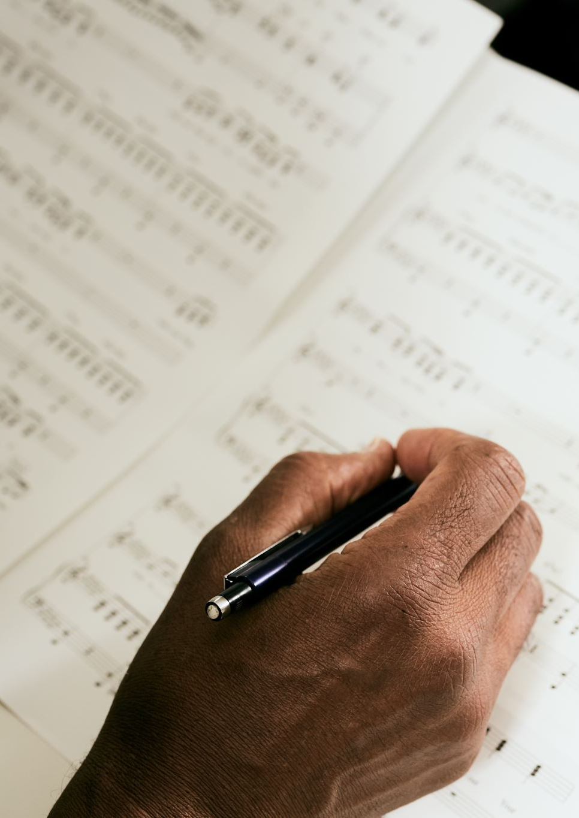
Purpose
Analysis of Rock, Country, R&B and HipHop/Rap lyrics to see if we could use ML to tell them apart purely on their lyrics
Answer the question if there is a difference between the lyrics of different songs. Do different genres of music have different messages?
For this we used a lyric dataset from Kaggle, with 4 genres. Scraped from four different sources.
https://www.kaggle.com/datasets/elizzyliu/song-lyrics

Slide 3
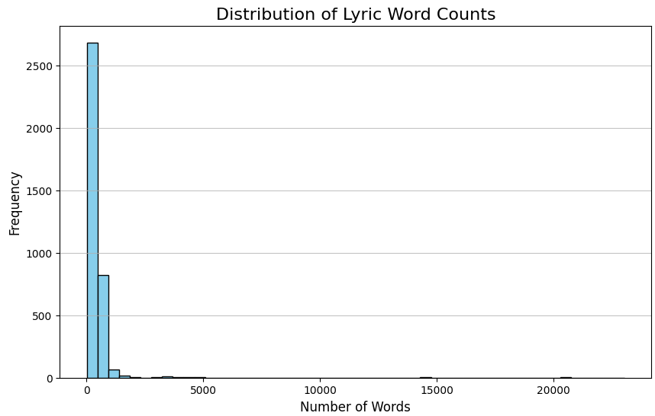
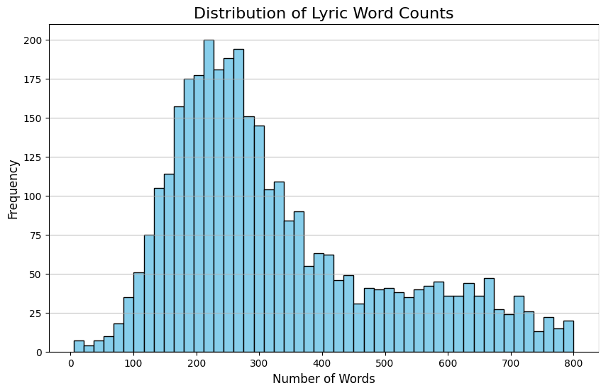
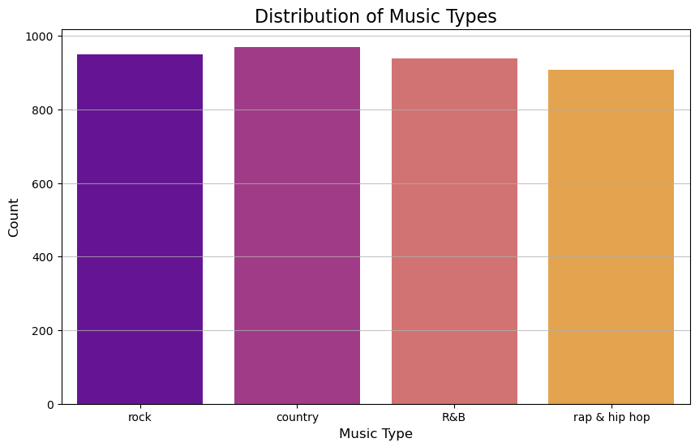
Cleaning and Preliminary Analysis
Dataset was not great as it was scraped from different sources
Removed special characters
Removed foreign words
Some ‘lyrics’ were incorrect scrapings and resulted in super long text – cut it down to 5-1000 words
Result was a balanced dataset

Slide 4
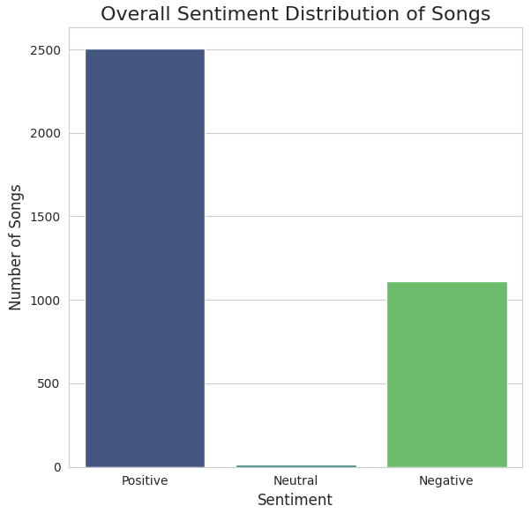
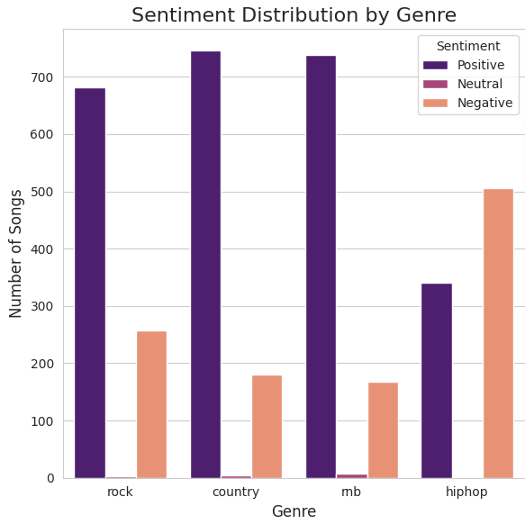
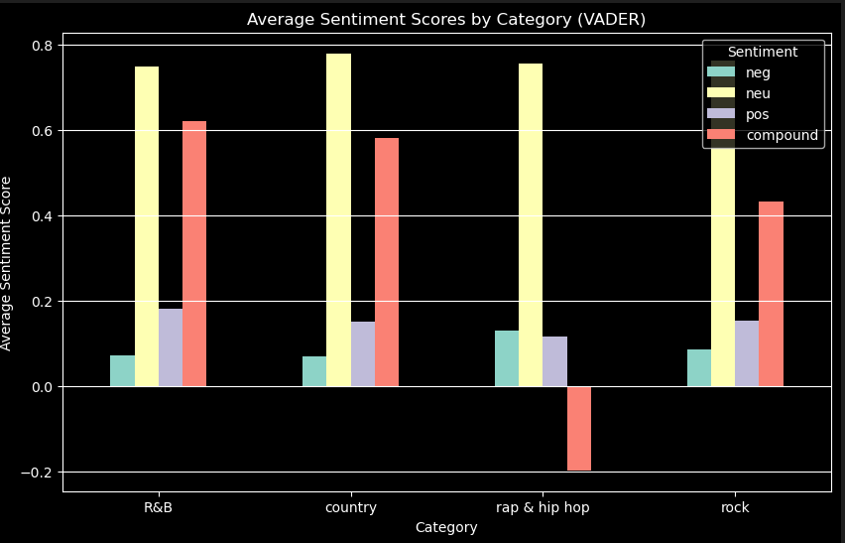
Interesting Statistics

Slide 5
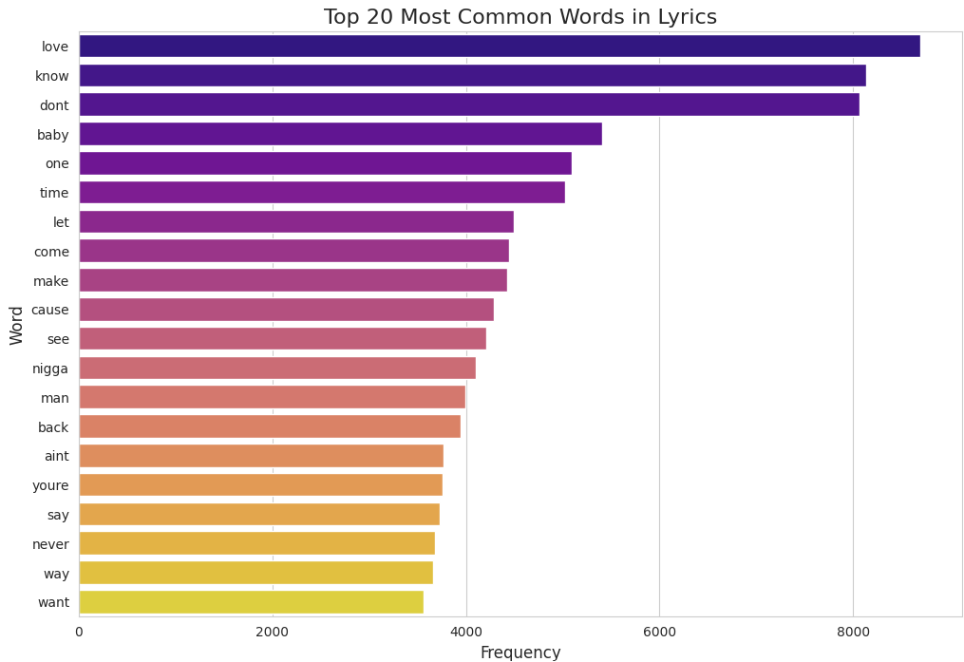
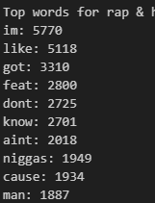
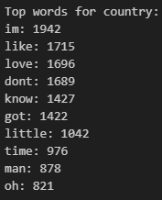
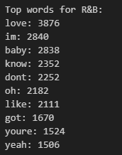
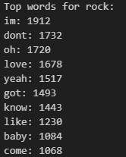
Top Words

Slide 6
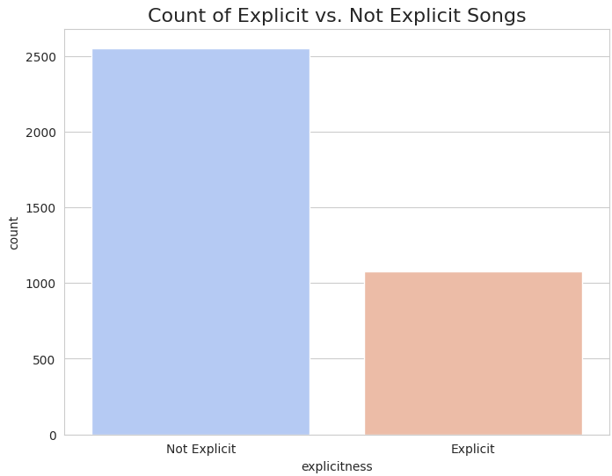
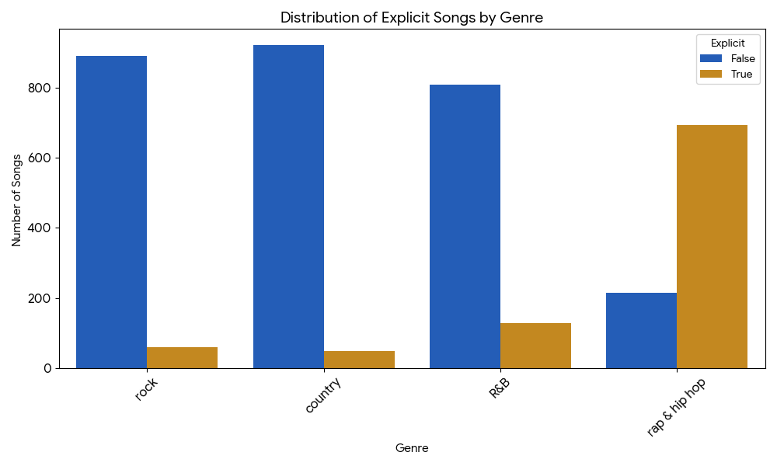
Explicit Lyrics
Gurmat’s List of Dirty Words

Slide 7
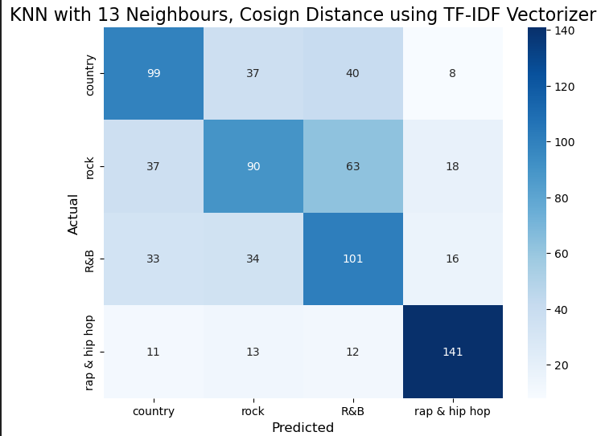
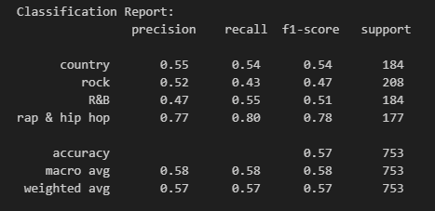
Analysis: KNN
Tried 7 to 19 neighbours, this was the best
Count vectorizer
Cosine distance gave a bit better results
Seemed to be able to pick out Rap/HipHop well

Slide 8
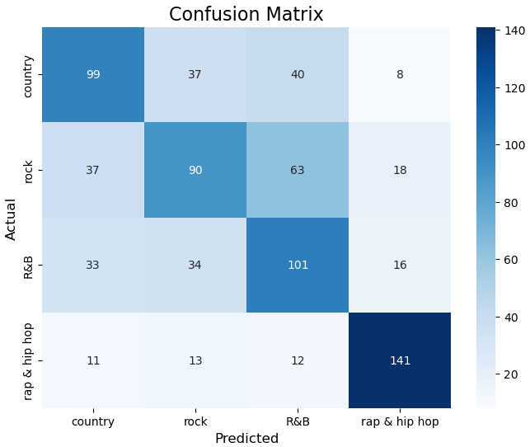
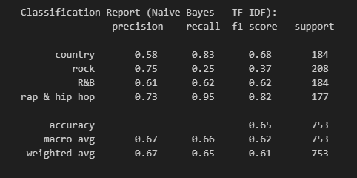
Analysis: Naïve Bayes
TF-IDF Vectorizer
Best results with classical ML models

Slide 9
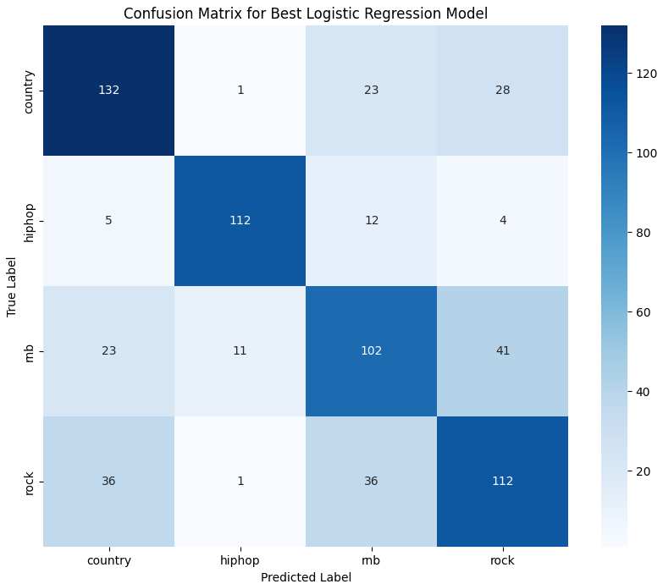
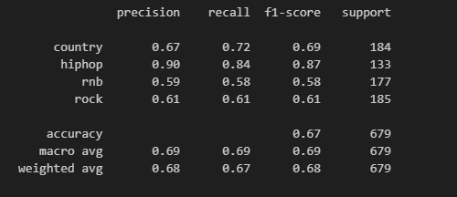
Analysis: Logistic Regression
Lemmatizer
Hyperparameter tuning
LibLinear Solver
Really likes HipHop

Slide 10
"I'd like to say thank you on behalf of the group and ourselves, and I hope we've passed the audition."
*John Lennon at the end of ‘Get Back’ by the Beatles

